Slide 1
Applicative Project-1
Title:
Intelligent Machines in Vehicle Platooning
Done by:
1. S. Sri Sai Sir
2.Keerthana Bollepally
3.Alaka Asritha Ghantasala
4.Riya Reddy
Supervisor Name:
Dr.ReddyShekar
SOT-School of Technology Woxsen University

Slide 2
Applicative Project-1
Title:
Contents:
Abstract
Introduction
Literature survey
Protocols
Proposed System
Software Requirements
Hardware Requirement

Slide 3
Applicative Project-1
Abstract
This project focuses on developing an advanced vehicle platooning system that is adaptable to various vehicle types, including trucks, buses, and cars.
Utilize existing communication standards, including Cellular Vehicle-to-Everything (C-V2X)and URLLC (Ultra-Reliable Low Latency Communication).
Integrate Geographic Routing Protocol (GRP) and Greedy Perimeter Stateless Routing (GPSR) in vehicle platooning.
Created visual tools to compare protocol outcomes across various platooning scenarios.

Slide 4
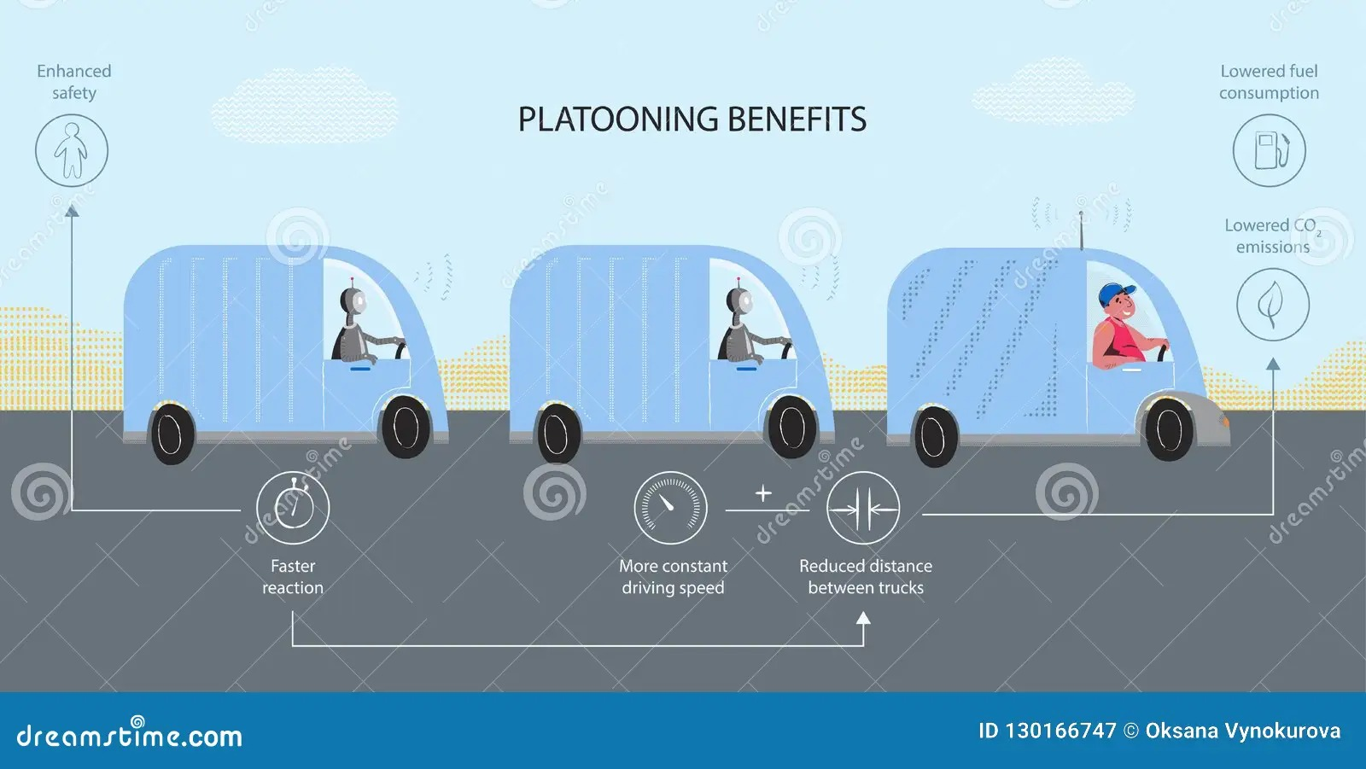
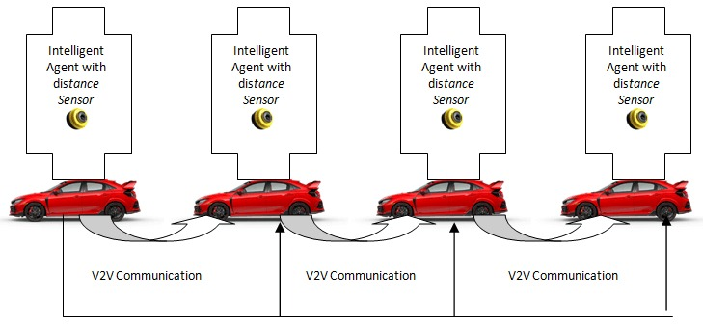
Applicative Project-1
Introduction
Vehicle platooning refers to a group of vehicles that travel closely together, coordinated through automated driving technologies and Vehicle-to-Vehicle (V2V) communication.
The primary goal is to improve road safety, reduce fuel consumption, and enhance traffic flow.

Slide 5
Applicative Project-1
Literature Survey
Joglekar, Maitreyi, and Amraja Shivkar. "Autonomous Cars - A Survey on C-V2X Technology." International Journal of Innovative Research in Electrical, Electronics, Instrumentation and Control Engineering, vol. 7, no. 8, 2019, pp. 27-31. doi:10.17148/IJIREEICE.2019.7804.
Pandith, Mamtha M., et al. "A Comprehensive Review of Geographic Routing Protocols in Wireless Sensor Network." Information Dynamics and Applications, vol. 1, no. 1, 2022, pp. 14-25. DOI: 10.56578/ida010103
Aarts, Loes, et al. "European Truck Platooning Challenge 2016: Creating Next Generation Mobility / Lessons Learnt." Rijkswaterstaat, 2016.
Perdana, Doan, Zaim, A. A., Hikmaturokhman, A., Irsyad, A. M., & Marthaliana. "Analysis of Greedy Perimeter Stateless Routing Protocol Network Simulation Using Bird Flocking Algorithm." Jurnal Infotel, vol. 14, no. 1, Feb. 2022, pp. 15-19.

Slide 6
Applicative Project-1
Protocols
GPSR (Greedy Perimeter Stateless Routing):
GPSR is another routing protocol that uses geographic information for packet forwarding. In platooning, GPSR can be used when vehicles are in direct communication with each other and infrastructure, especially when traditional greedy forwarding methods fail, or there are obstacles or network partitions.
Primary Functions:
1.Greedy Forwarding
2.Perimeter Mode
GRP (Geographic Routing Protocol):
GRP is a routing protocol used to determine the path for data transmission based on geographic information. In vehicle platooning, especially in cases where vehicles are spread out over a large area or need to communicate with remote infrastructure.
Primary functions:
1.Location-Based Forwarding
2.Reduced Routing Table Complexity.

Slide 7
Applicative Project-1
Protocols
C-V2X (Cellular Vehicle-to-Everything):
Cellular-based communication technology for Vehicle-to-Vehicle (V2V), Vehicle-to-Infrastructure (V2I), Vehicle-to-Pedestrian (V2P), and Vehicle-to-Network (V2N).
Key Features:
1.Enables direct communication between vehicles and infrastructure (without cellular network).
2.Facilitates real-time, low-latency data exchange.
3.Supports safety and efficiency in autonomous driving and vehicle platooning.
URLLC (Ultra-Reliable Low Latency Communication):
A key feature in 5G networks, ensuring ultra-reliable and low-latency communication.
Key Features:
1.End-to-end latency < 1ms and extremely high reliability (99.999%).
2.Essential for mission-critical applications (autonomous driving, industrial automation, remote surgery).

Slide 8
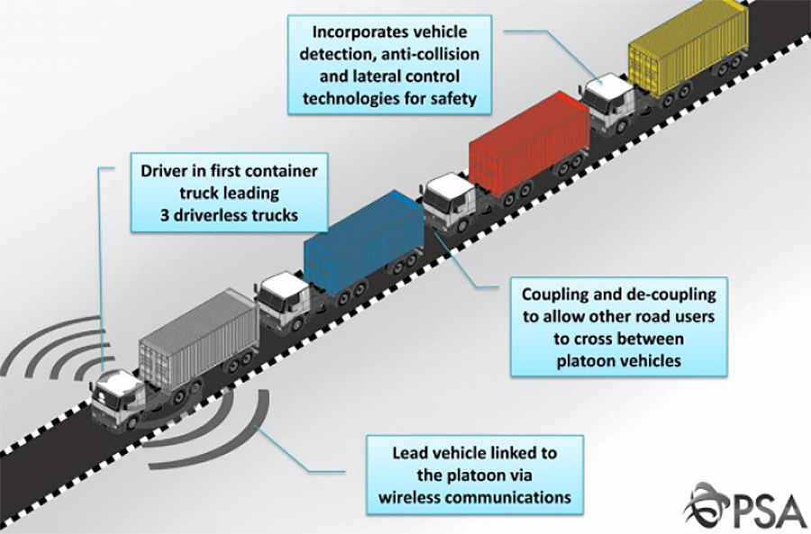
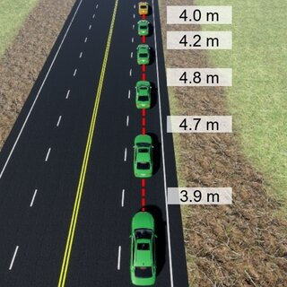
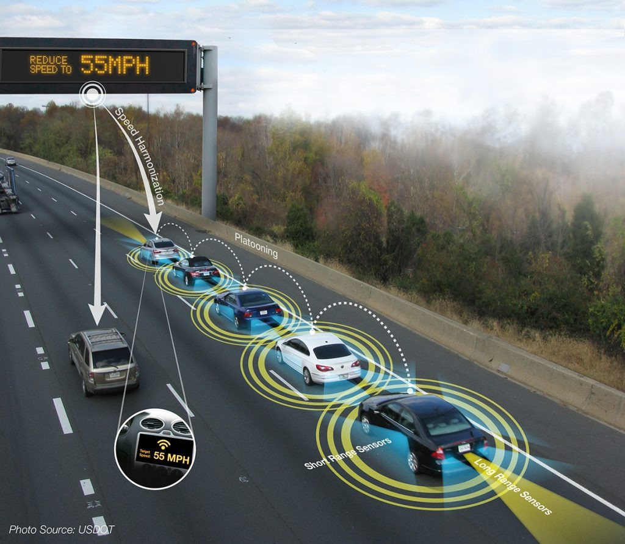
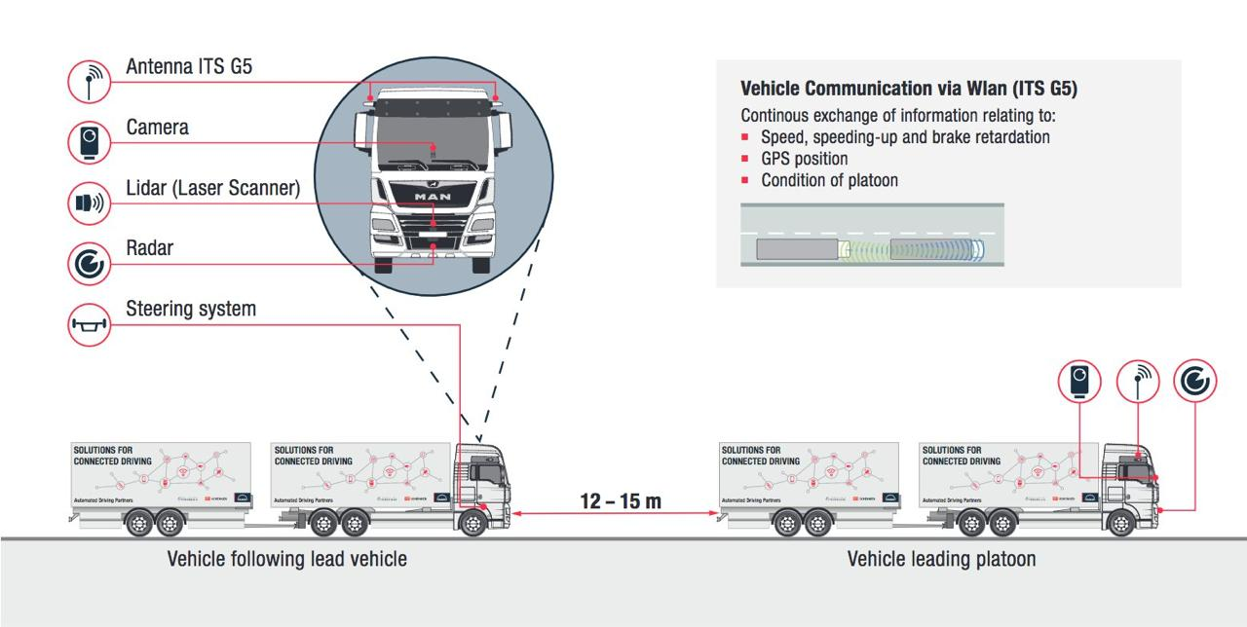

Slide 9
Applicative Project-1
Proposed System
Developed a Python-based simulation environment for intelligent vehicle platooning.
Implemented diverse communication protocols (C-V2X, URLLC, GRP, GPSR) to support reliable and efficient vehicle-to-vehicle and vehicle-to-infrastructure communication.
Created graph-based visualizations to model and assess platooning behaviors, focusing on network efficiency, reliability, and latency.
Evaluated each protocol's impact on platoon safety and operational effectiveness, identifying optimal strategies for enhancing platooning performance.

Slide 10
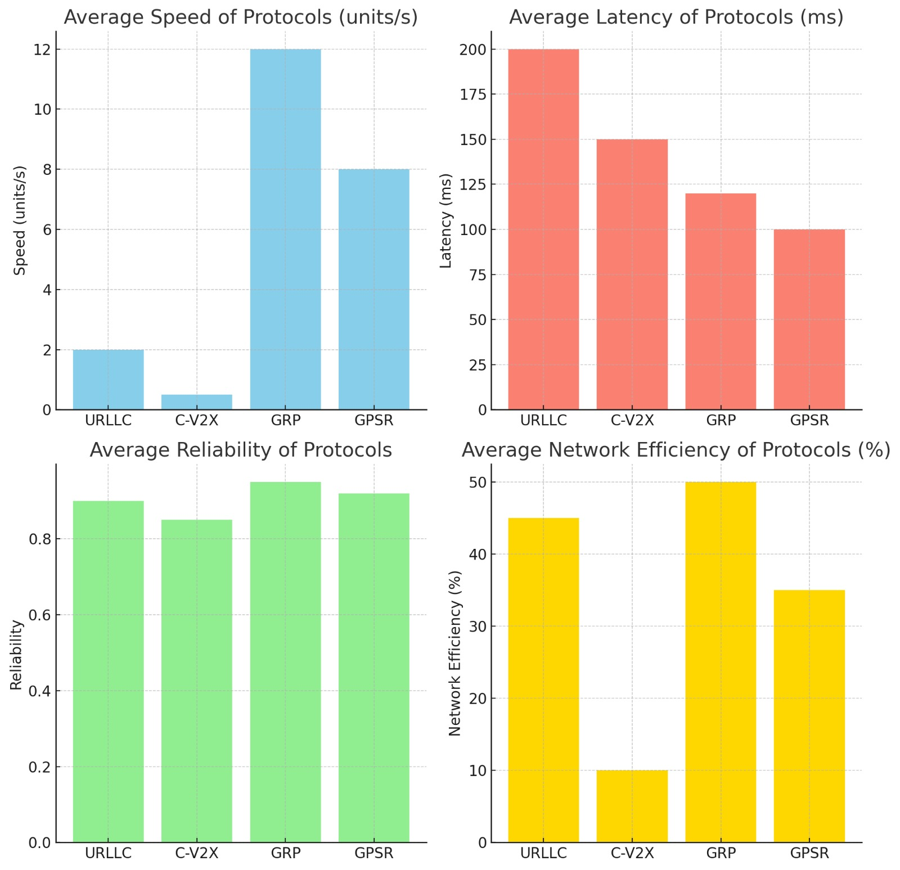
Applicative Project-1
Proposed System

Slide 11
Applicative Project-1
Software Requirements
•Python Version: The application should be developed using Python 3.x to leverage the latest features and libraries.
•Required Libraries: It must include necessary Python libraries such as NumPy and Matplotlib for data processing and visualization, which should be specified in the documentation for installation.
•Operating Systems: The application should be designed to work on multiple operating systems, including Windows, macOS, and Linux, ensuring broad accessibility for users.

Slide 12
Applicative Project-1
Hardware Requirements
Processor: A multi-core processor (e.g., Intel i5 or equivalent) to handle computational tasks efficiently.
RAM: At least 8 GB of RAM to support smooth operation during simulations, especially for larger scenarios.
Storage: Sufficient disk space to store simulation data and results, with at least 500 MB available for installation and running simulations.

Slide 13
Applicative Project-1
Thanking You

